Slide 1
Advanced Database Management System (CoSc3052)
Object Oriented Databases

Slide 2
Introduction
Traditional Data Models:
  Hierarchical
  Network (since mid-60’s)
  Relational (since 1970 and commercially since 1982)
Object Oriented (OO) Data Models since mid-90’s

Slide 3
Introduction
Reasons for creation of Object Oriented Databases
  Need for more complex applications
  Need for additional data modeling features
  Increased use of object-oriented programming languages
Commercial OO Database products –
  Several in the 1990’s, but did not make much impact on mainstream data management

Slide 4
History of OO Models and Systems
Languages:
  Simula (1960’s)
  Smalltalk (1970’s)
  C++ (late 1980’s)
  Java (1990’s and 2000’s)

Slide 5
History of OO Models and Systems (cont'd.)
Experimental Systems:
  Orion at MCC
  IRIS at H-P labs
  Open-OODB at T.I.
  ODE at ATT Bell labs
  Postgres - Montage - Illustra at UC/B
  Encore/Observer at Brown

Slide 6
History of OO Models and Systems (cont'd.)
Commercial OO Database products:
  Ontos
  Gemstone
  O2 ( -> Ardent)
  Objectivity
  Versant
  Object Store (Object Design)
  Jasmine (Fujitsu – GM)

Slide 7
Overview of Object-Oriented Concepts
Main Claim:
  OO databases try to maintain a direct correspondence between real-world and database objects so that objects do not lose their integrity and identity and can easily be identified and operated upon
Object:
  Two components:
    state (value) and behavior (operations)
  Instance variables
    Hold values that define internal state of object
  Operation is defined in two parts:
    Signature or interface and implementation

Slide 8
Overview of Object-Oriented Concepts (cont'd)
In OO databases, objects may have an object structure of arbitrary complexity in order to contain all of the necessary information that describes the object.
In contrast, in traditional database systems, information about a complex object is often scattered over many relations or records, leading to loss of direct correspondence between a real-world object and its database representation.

Slide 9
Overview of Object Database Concepts
Origins in OO programming languages
Object databases (ODB)
  Object data management systems (ODMS)
  Meet some of the needs of more complex applications
  Specify:
    Structure of complex objects
    Operations that can be applied to these objects

Slide 10
Overview of Object Database Concepts (cont’d.)
Object Identity:
  An OO database system provides a unique identity to each independent object stored in the database.
  This unique identity is typically implemented via a unique, system-generated object identifier, or OID
The main property required of an OID is that it be immutable
  Specifically, the OID value of a particular object should not change.
  This preserves the identity of the real-world object being represented.

Slide 11
Overview of Object Database Concepts (cont’d.)
Inheritance
  Permits specification of new types or classes that inherit much of their structure and/or operations from previously defined types or classes
Operator overloading
  Operation’s ability to be applied to different types of objects
  Operation name may refer to several distinct implementations

Slide 12
Complex Type Structures for Objects and Literals
Structure of arbitrary complexity
  Contain all necessary information that describes object or literal
Nesting type constructors
  Construct complex type from other types
Most basic constructors:
  Atom
  Struct (or tuple)
  Collection

Slide 13
Complex Type Structures for Objects and Literals (cont’d.)
Collection types:
  Set
  Bag
  List
  Array
  Dictionary
Object definition language (ODL)
  Used to define object types for a particular database application

Slide 14
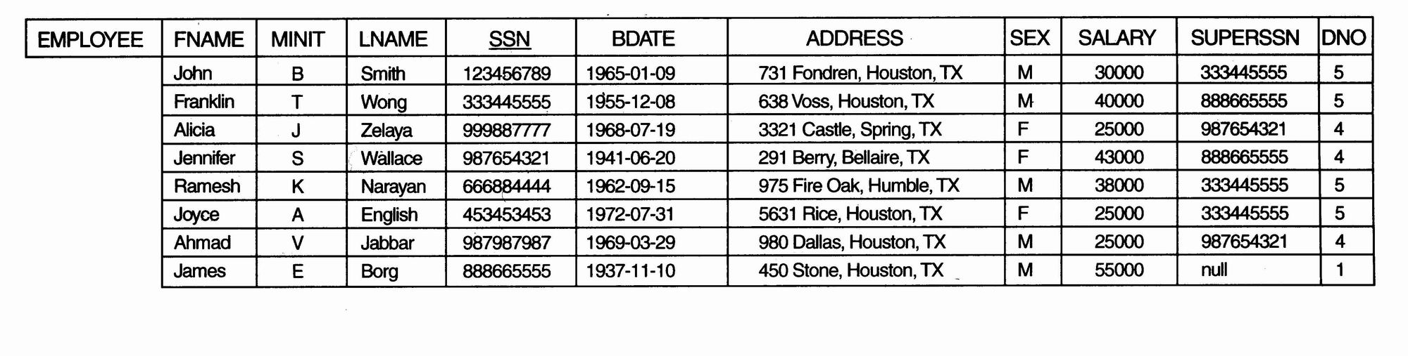
Complex Type Structures for Objects and Literals (cont’d.)
Example
  One possible relational database state corresponding to COMPANY schema

Slide 15
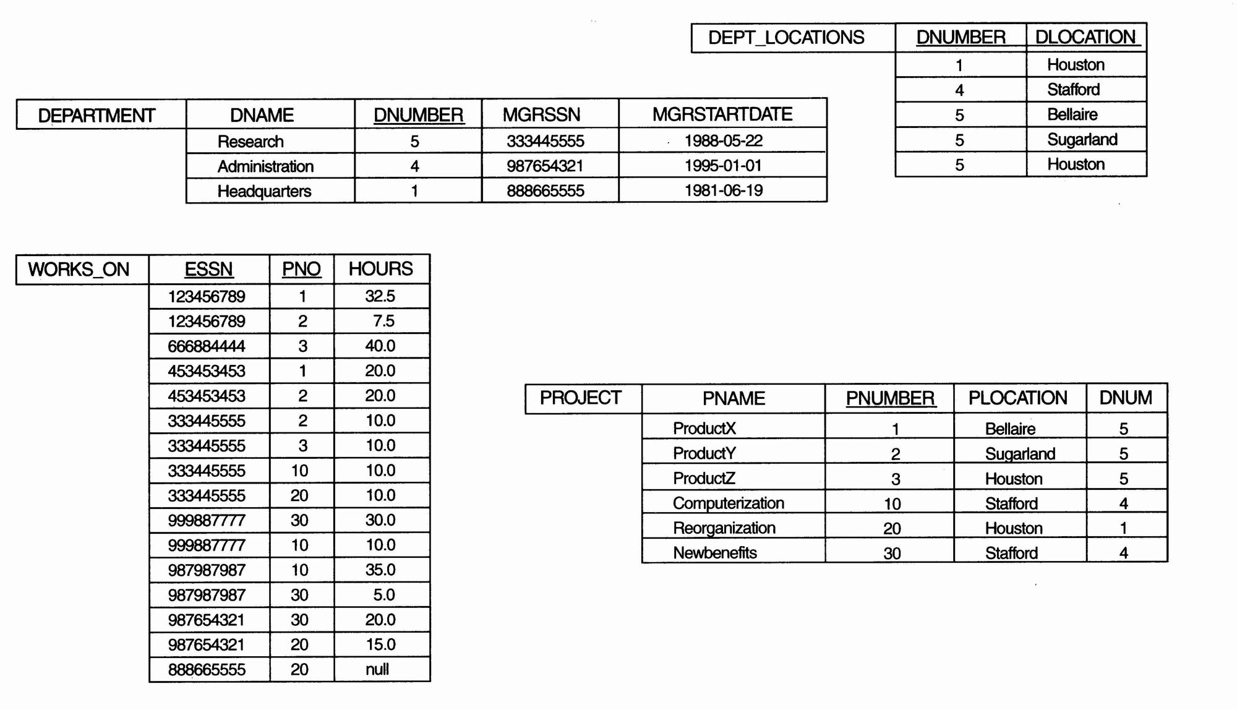
Complex Type Structures for Objects and Literals (cont’d.)

Slide 16
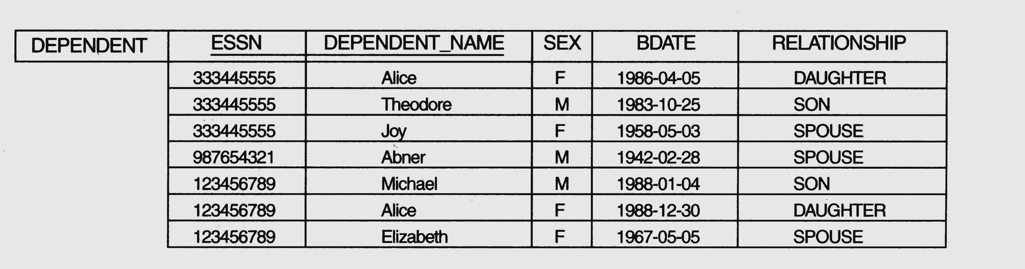
Complex Type Structures for Objects and Literals (cont’d.)

Slide 17
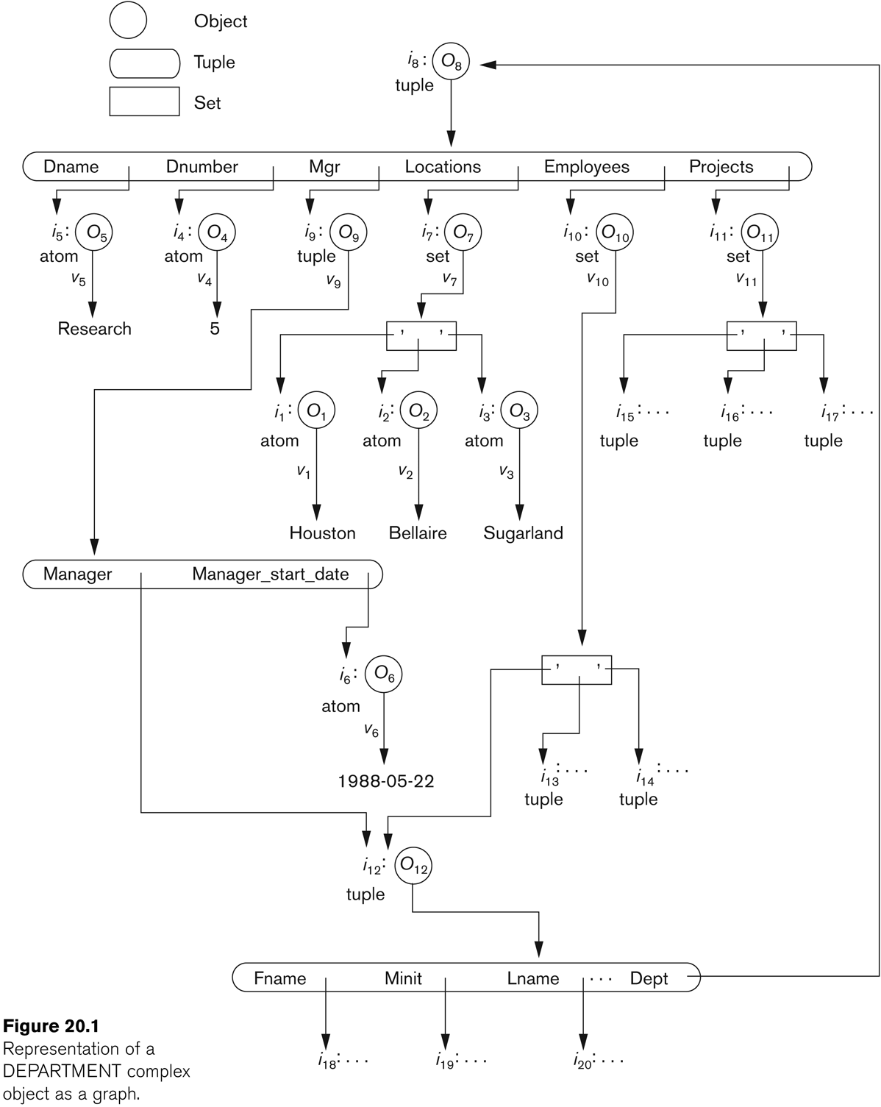

Slide 18
Complex Type Structures for Objects and Literals (cont’d.)
The first six objects listed in this example represent atomic values.
Object seven is a set-valued object that represents the set of locations for department 5; the set refers to the atomic objects with values {‘Houston’, ‘Bellaire’, ‘Sugarland’}.
Object 8 is a tuple-valued object that represents department 5 itself, and has the attributes DNAME, DNUMBER, MGR, LOCATIONS, and so on.

Slide 19
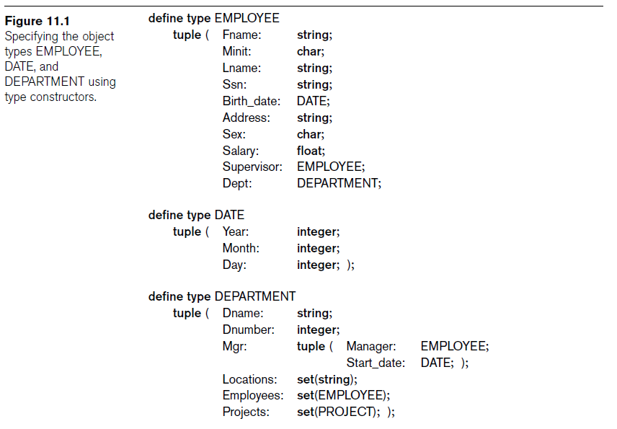

Slide 20
Encapsulation of Operations and Persistence of Objects
Encapsulation
  Related to abstract data types and information hiding in programming languages
  Define behavior of a type of object based on operations that can be externally applied
  External users only aware of interface of the operations
  Divide structure of object into visible and hidden attributes

Slide 21
Encapsulation of Operations and Persistence of Objects
Some OO models insist that all operations a user can apply to an object must be predefined. This forces a complete encapsulation of objects.
To encourage encapsulation, an operation is defined in two parts:
  signature or interface of the operation, specifies the operation name and arguments (or parameters).
  method or body, specifies the implementation of the operation.

Slide 22
Encapsulation of Operations and Persistence of Objects
Object constructor
  Used to create a new object
Destructor operation
  Used to destroy (delete) an object
Modifier operations
  Modify the states (values) of various attributes of an object
Retrieve information about the object
Dot notation used to apply operations to object

Slide 23
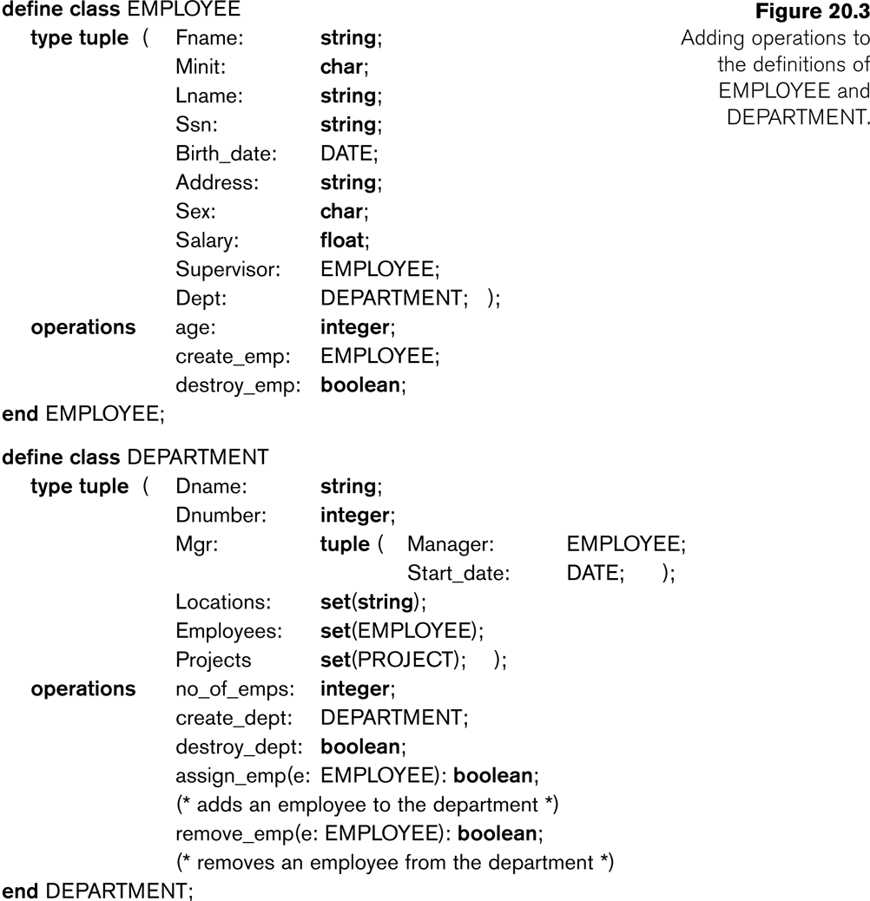

Slide 24
Encapsulation of Operations and Persistence of Objects
Transient objects
  Exist in executing program
  Disappear once program terminates
Persistent objects
  Stored in database and persist after program termination
  Naming mechanism
  Reachability

Slide 25
Object Identity and Pointers
A persistent object is assigned a persistent object identifier.
Degrees of permanence of identity:
  Intraprocedure – identity persists only during the executions of a single procedure
  Intraprogram – identity persists only during execution of a single program or query.
  Interprogram – identity persists from one program execution to another, but may change if the storage organization is changed
  Persistent – identity persists throughout program executions and structural reorganizations of data; required for object-oriented systems.

Slide 26
Type Hierarchies and Inheritance
Inheritance
  Definition of new types based on other predefined types
  Leads to type (or class) hierarchy
Type: type name and list of visible (public) functions
  Format:
    TYPE_NAME: function, function, ..., function

Slide 27
Type Hierarchies and Inheritance (cont’d.)
Subtype
  Useful when creating a new type that is similar but not identical to an already defined type
  Example:
    EMPLOYEE subtype-of PERSON: Salary, Hire_date, Seniority
    STUDENT subtype-of PERSON: Major, Gpa

Slide 28
Type Hierarchies and Inheritance (cont’d.)
Example:
  Consider a type that describes objects in plane geometry, which may be defined as follows:
    GEOMETRY_OBJECT: Shape, Area, ReferencePoint
  Now suppose that we want to define a number of subtypes for the GEOMETRY_OBJECT type, as follows:
    RECTANGLE subtype-of GEOMETRY_OBJECT: Width, Height
    TRIANGLE subtype-of GEOMETRY_OBJECT: Side1, Side2, Angle
    CIRCLE subtype-of GEOMETRY_OBJECT: Radius

Slide 29
Other Object-Oriented Concepts
Polymorphism of operations
  Also known as operator overloading
  Allows same operator name or symbol to be bound to two or more different implementations
  Depending on type of objects to which operator is applied
Multiple inheritance
  Subtype inherits functions (attributes and methods) of more than one supertype

Slide 30
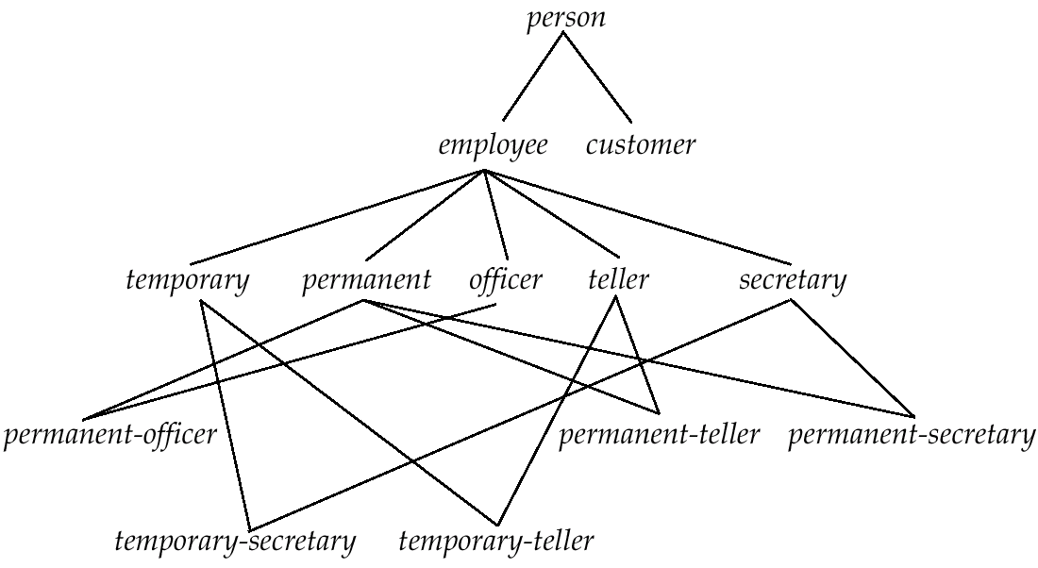
Multiple Inheritance

Slide 31
Other Object-Oriented Concepts (cont’d.)
Selective inheritance
  Subtype inherits only some of the functions of a supertype

Slide 32
Summary
Object identity
Type constructor
Encapsulation of operations
Programming language compatibility
Type hierarchies and inheritance
Polymorphism and operator overloading

